Slide 1
Unit 1: The Online World
Learning aim C: Investigate issues with operating online

Slide 2
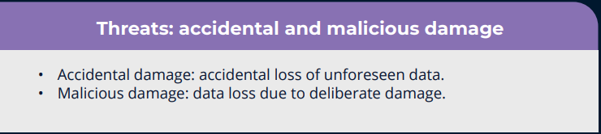
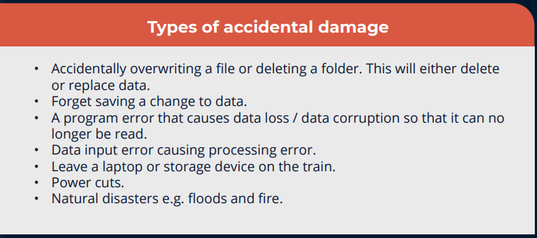
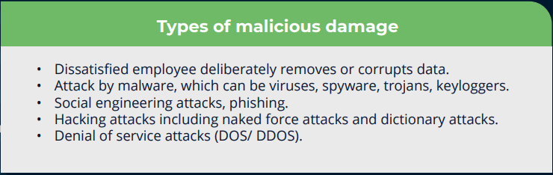
Explain Possible threats to data
You are a Cyber Security Apprentice at Bolton College and have been charged with researching into threats to Data that can occur and how to minimise them.
  ● malicious and accidental damage to data and situations where either could occur

Slide 3
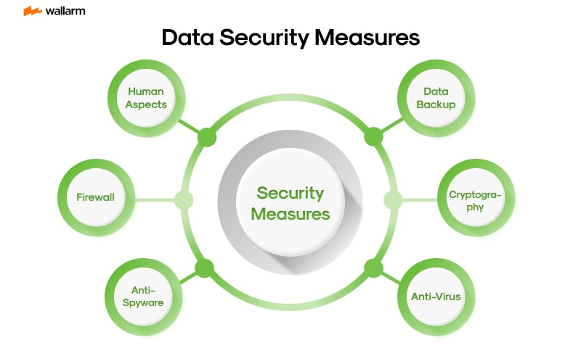
Explain Possible threats to data
You are a Cyber Security Apprentice at Bolton College and have been charged with researching into threats to Data that can occur and how to minimise them.
  ● security measures taken to protect data that is transmitted and stored digitally including encryption, firewalls and anti-virus software

Slide 4
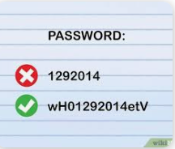
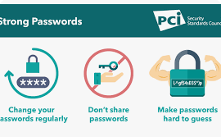
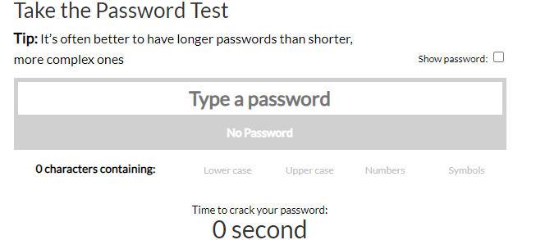
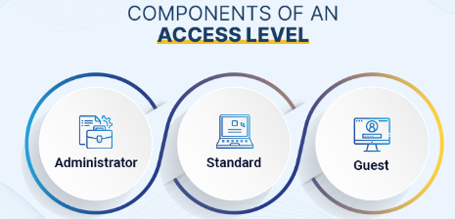
Explain Possible threats to data
You are a Cyber Security Apprentice at Bolton College and have been charged with researching into threats to Data that can occur and how to minimise them.
  ● measures taken to protect the security and integrity of data, including passwords, levels of permitted access, firewalls and anti-virus software

Slide 5
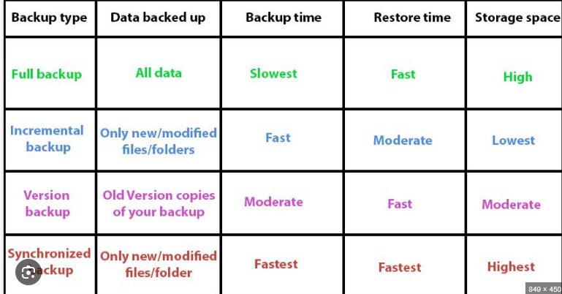
Explain Possible threats to data
You are a Cyber Security Apprentice at Bolton College and have been charged with researching and into threats to Data that can occur and how to minimise them.
  ● the need to backup data and identify and describe different procedures for backing up data.

Slide 6
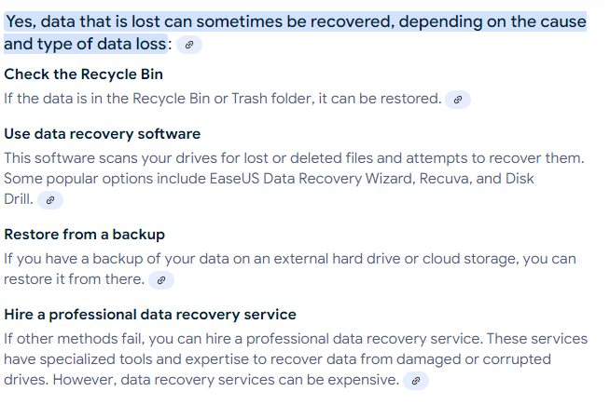
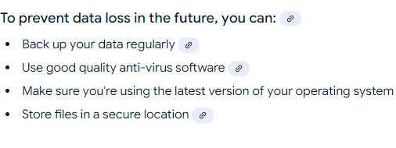
Explain Possible threats to data
● Explain can and how data might be recovered if lost ?

Slide 7
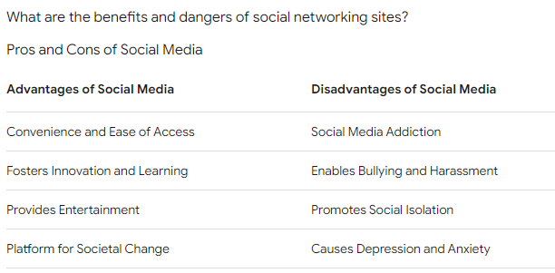
explainPossible threats to data
● Explain the benefits and possible inherent dangers of widespread use of social networking websites and instant messaging ?

Slide 8
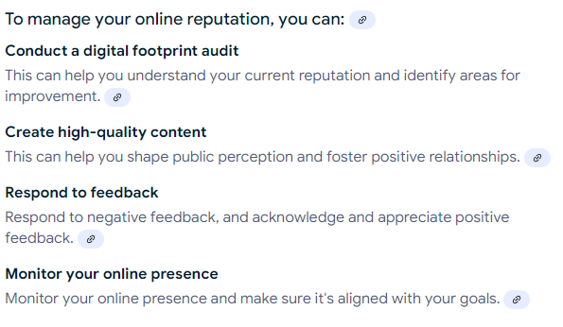
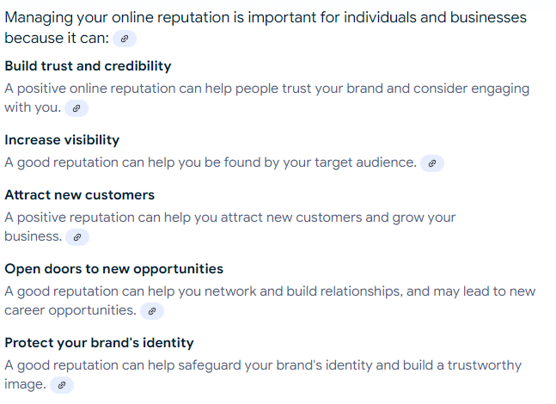
Explain Possible threats to data
● Explain The importance to individuals of the management of their e-reputation ?

Slide 9
Explain Possible threats to data
● Explain security issues and consequences associated with the widespread use of:
email, including spread of viruses, phishing and identity theft.

Slide 10
Possible threats to data
Consider ways in which online technology can be used to monitor individuals’ movements and communications. In relation to IT systems, consider how current legislation controls how personal data can be used and must be protected by organisations

