Slide 1
unit 2 Technology systems
Learning Aim B understand how data flows between internal components of a computer and is processed to provide information

Slide 2
Learning Aim B
Explain the main characteristics, functions and role of the internal components of a computer.

Slide 3
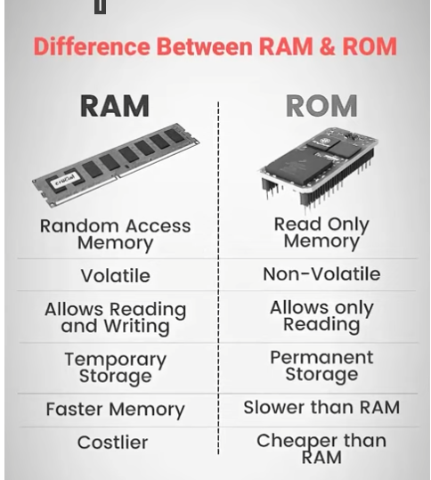
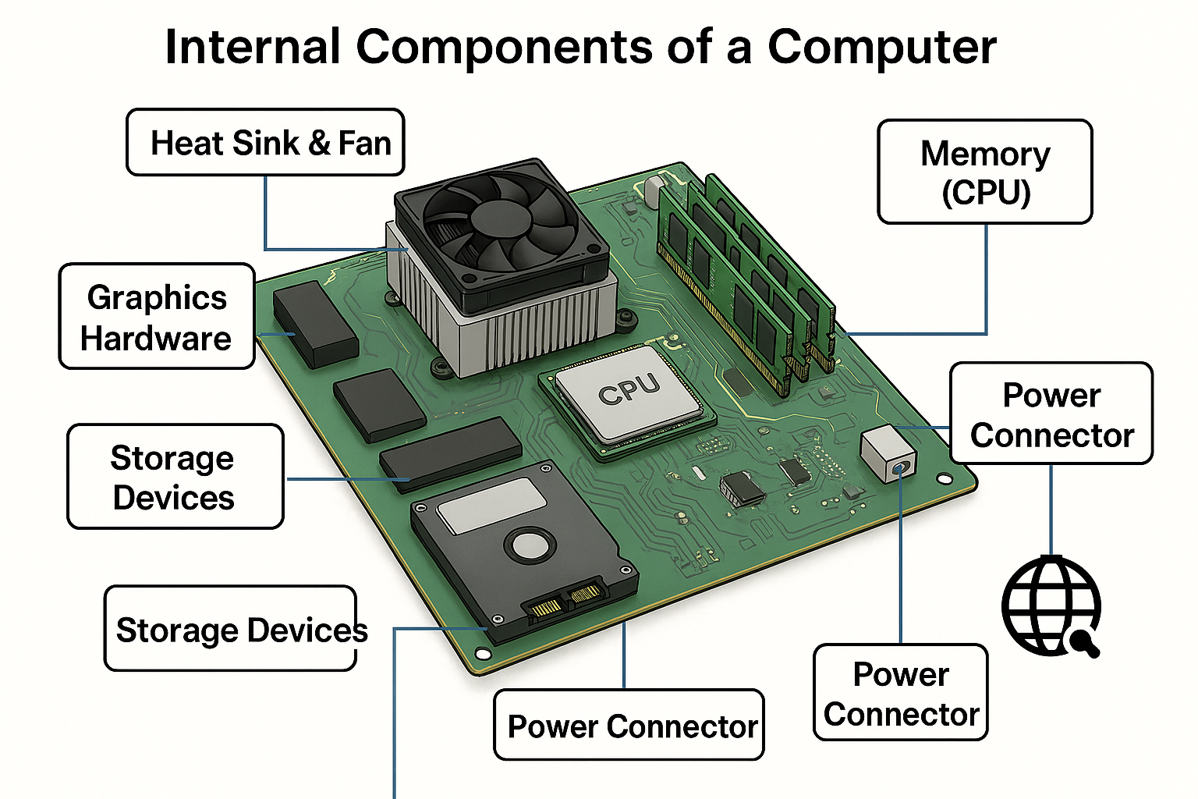
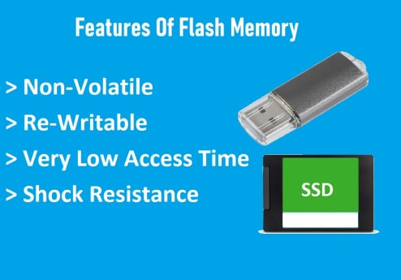
Internal components of a computer

Slide 4
Internal Components of a Computer
What is the role of the motherboard in a computer system?
How does the CPU process data using the ALU, control unit, and registers?
What are the differences between RAM, ROM, and Flash memory?
How do heat sinks and fans help maintain system performance?
What are the differences between solid state, optical, and magnetic storage?
How do internal components affect the speed and responsiveness of a computer?
Why is it important to compare specifications when choosing components?
Notes:
Internal computer components dictate speed and responsiveness by determining how fast data is processed, accessed, and transferred. The primary components influencing performance are the CPU, RAM, and storage drive, which work together to handle tasks ranging from everyday browsing to heavy gaming or content creation.
Registers : the fastest, smallest, and most essential high-speed storage locations directly inside the CPU, designed for immediate access to data, instructions, and memory addresses during processing.
Motherboard: Main circuit board connecting all components and allowing communication.
CPU Processing:
ALU performs calculations and logic.
Control Unit manages instructions and flow.
Registers store small amounts of data the CPU needs instantly.
RAM/ROM/Flash:
RAM = temporary, fast memory.
ROM = permanent startup instructions.
Flash = rewritable storage, used in SSDs/USBs.
Cooling: Heat sinks + fans remove heat to prevent slowdowns.
Storage Types:
SSD fast, no moving parts
HDD slower, magnetic
Optical uses lasers
Performance: Faster CPU, more RAM, and SSD improve speed.
Compare Specs: Ensures parts meet needs and avoid bottlenecks.

Slide 5
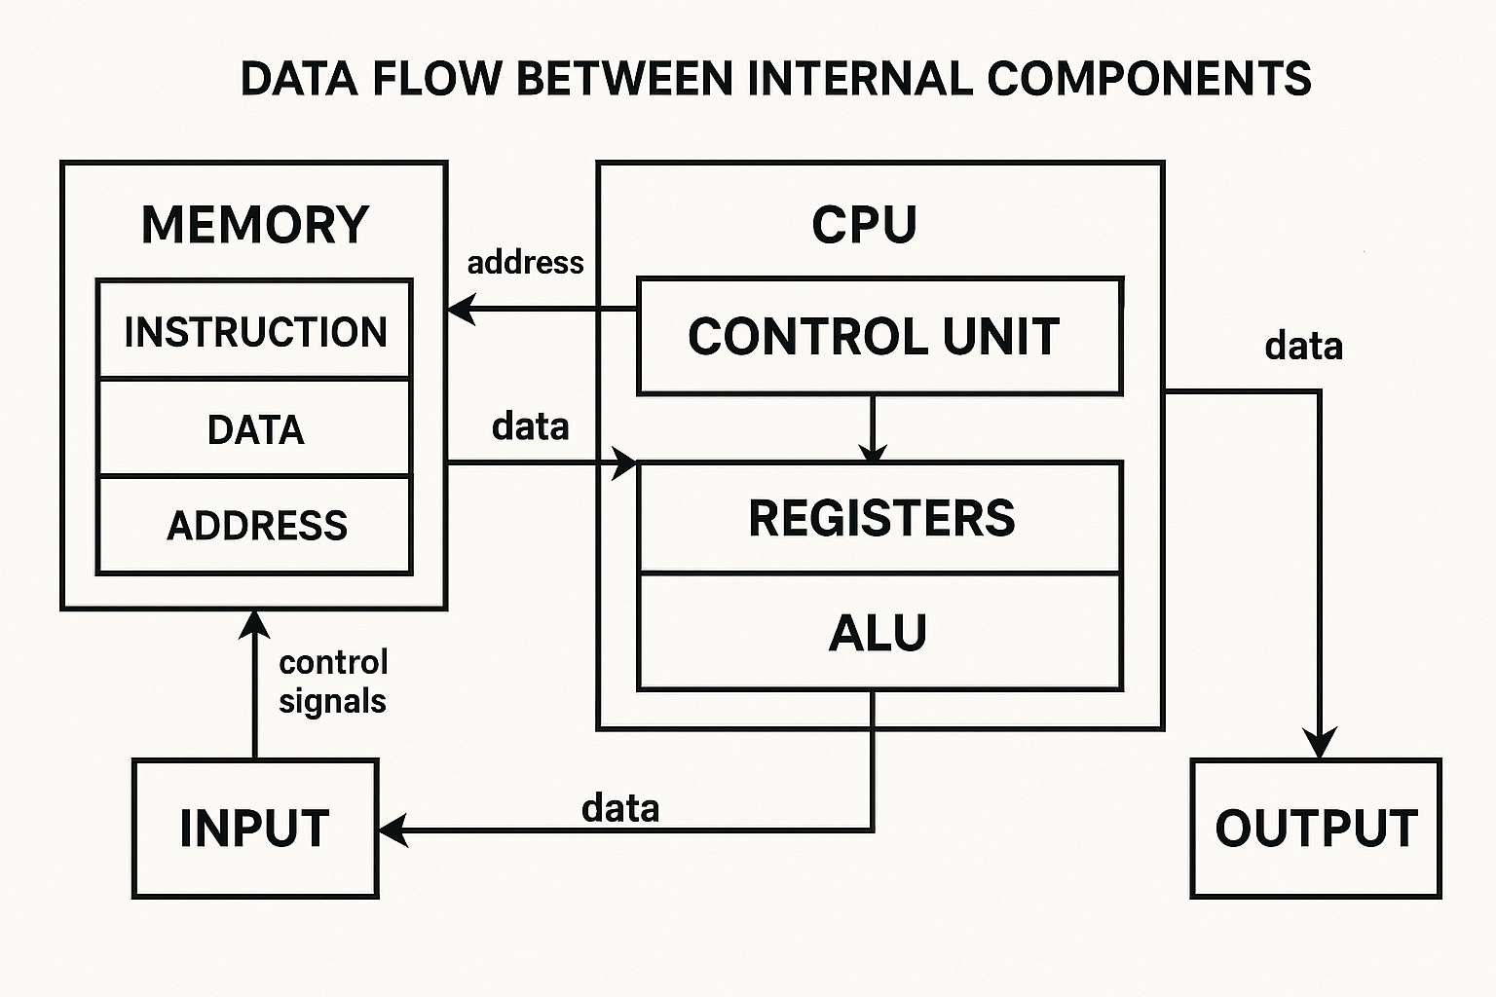
Internal Components of a Computer

Slide 6
CPU and GPU Performance Factors
How does clock speed influence CPU performance?
What is the function of cache memory in a processor?
What are the benefits of multiple processing cores?
How do heat and power consumption affect performance and design?
How does the GPU contribute to user experience in gaming and video editing?
Notes:
Clock speed determines how many instructions a processor can execute per second, measured in gigahertz (GHz). This clock/oscillator is located in a chip on the motherboard (the 'chipset’)
CPU cache memory is a small, ultra-fast memory built into or near the processor that stores frequently used data and instructions, acting as a crucial buffer between the CPU and slower main RAM to dramatically speed up operations
Clock Speed: Higher GHz = more instructions per second.
Cache: Very fast memory storing frequently used data.
Multiple Cores: Allows more tasks at once and improves performance.
Heat/Power: Too much heat slows CPU; good cooling maintains performance.
GPU Role: Handles graphics, improves gaming/video editing.

Slide 7
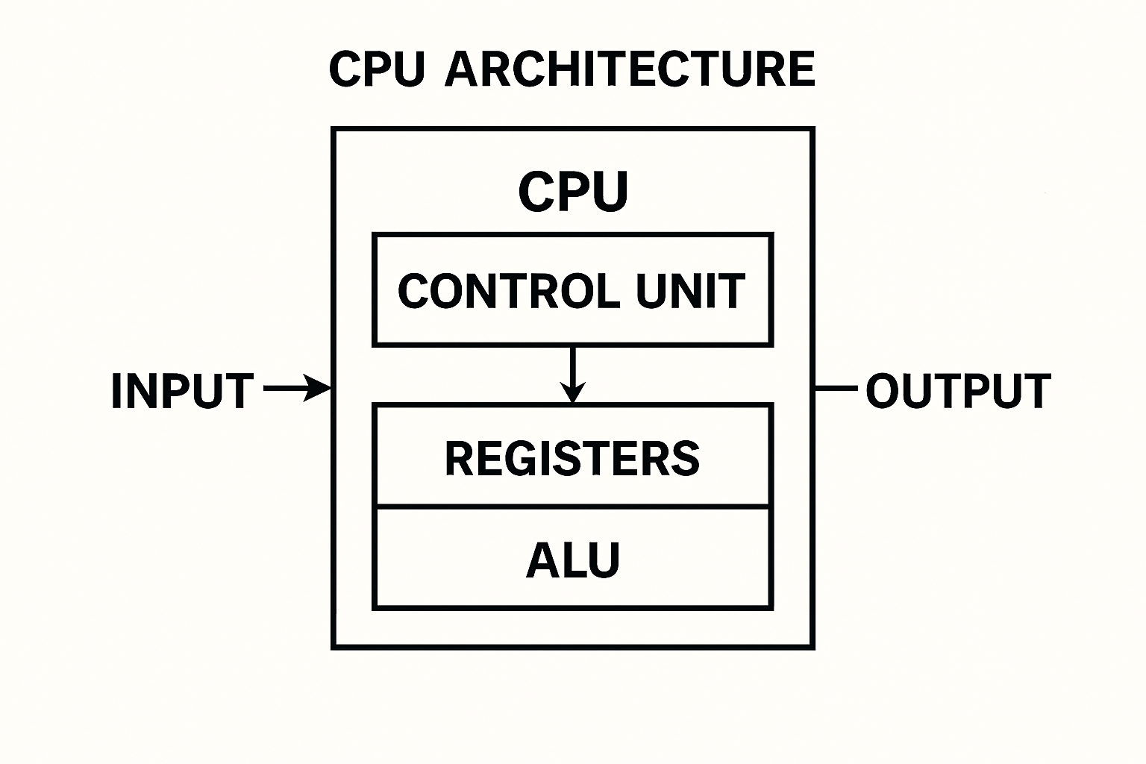
CPU

Slide 8
Mobile Devices vs Traditional Platforms
What is a System-on-a-Chip (SoC), and how does it differ from a traditional CPU?
How do mobile CPUs and GPUs differ from desktop versions?
Why is battery life a critical factor in mobile device performance?
What are the key differences between mobile and desktop computing platforms?
Notes:
A System-on-a-Chip (SoC) integrates a complete electronic system, including the CPU, memory, GPU, I/O, and other peripherals, onto a single integrated circuit (IC) or microchip
SoC: Combines CPU, GPU, memory, and I/O on one chip.
Mobile vs Desktop: Mobile = energy‑efficient, cooler; desktop = higher performance.
Battery Life: Important because mobile devices run on limited power.
Differences: Mobile is compact and low‑power; desktop is powerful but not portable

Slide 9
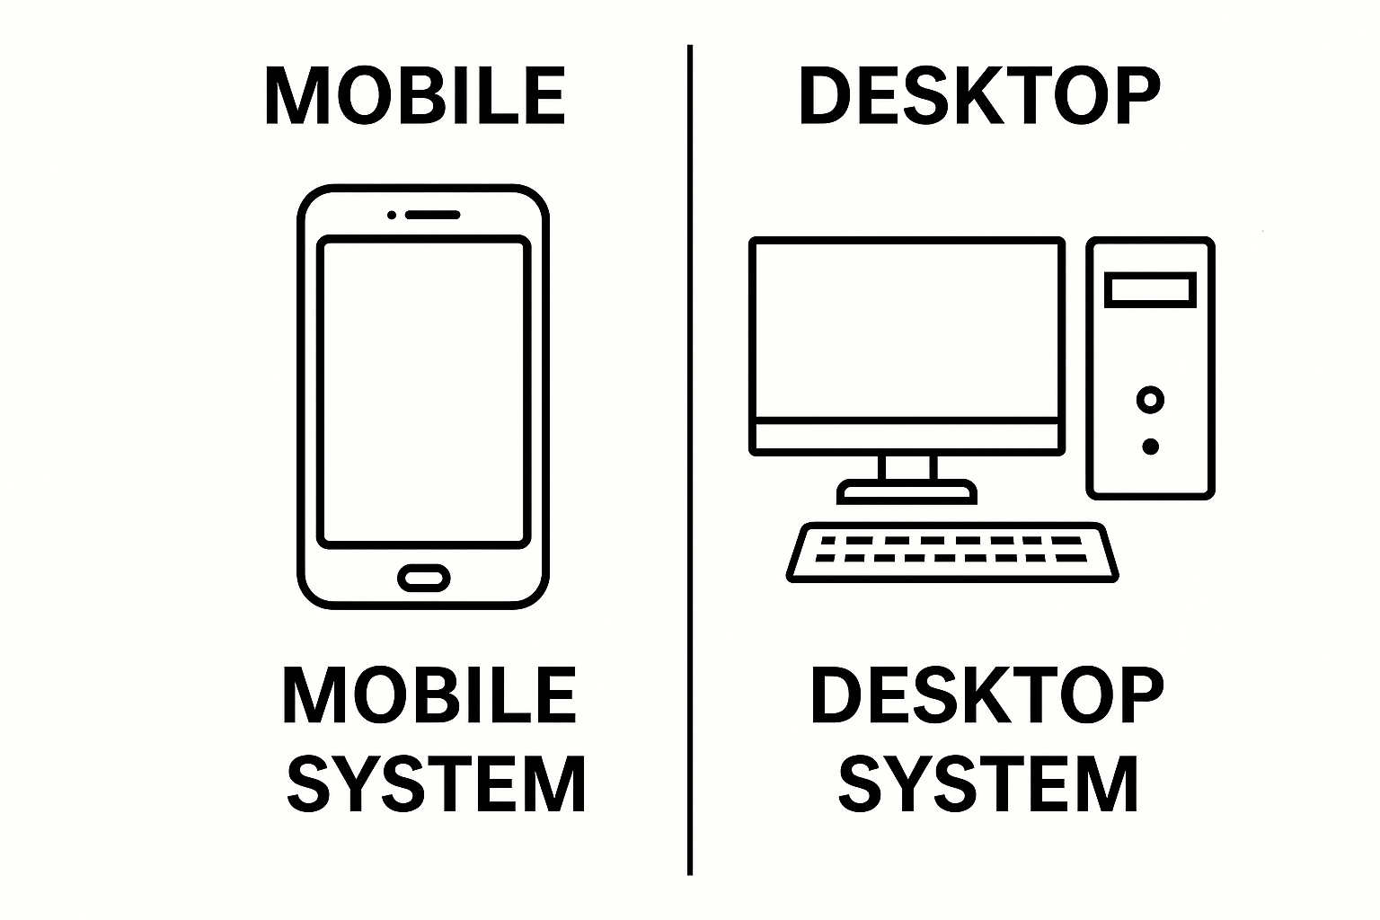
Mobile Devices vs Traditional Platforms

Slide 10
Memory and Storage Performance
How does RAM size affect multitasking and system speed?
What is the difference between cache and RAM?
Compare the performance of solid state drives vs magnetic hard drives.
Why might optical media still be used in some systems?
Notes:
RAM Size: More RAM = better multitasking and smoother performance.
Cache vs RAM: Cache is inside CPU and faster; RAM holds active data.
SSD vs HDD: SSD is much faster; HDD is slower mechanical storage.
Optical Media Uses: Archiving, older software, movie discs

Slide 11
Data Flow and Computer Buses
Analogue vs Digital Data
Data Flow and Computer Buses
What is the role of computer buses in data transmission?
How do buses connect internal components like CPU, memory, and storage?
What happens when a bus becomes a bottleneck?
Analogue vs Digital Data
What is the difference between analogue and digital signals?
Why do computers need to convert analogue signals to digital?
What devices perform analogue-to-digital conversion?
Notes:
Computer Buses: Transfer data between CPU, RAM, storage, and other components.
Connection: Buses act like data highways linking components.
Bottleneck: If a bus is slow, it slows the entire system.
Analogue vs Digital: Analogue = continuous; digital = 0s/1s.
Why Convert: Computers only use digital data.
ADC Devices: Microphones, cameras, scanners.

Slide 12
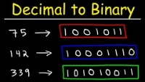
Decimal to Binary

Slide 13
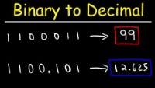
Binary to Decimal

Slide 14
Binary and Data Representation
How is data represented in binary format?
Convert the number 7 into binary.
Convert the binary number 10101010 into decimal.
What is the difference between a bit and a byte?
List the units of data storage from smallest to largest.
Notes:
Binary Representation: All computer data uses 0s and 1s.
7 in Binary: 111
10101010 in Decimal: 170
Bit vs Byte: Bit = 1 binary digit; Byte = 8 bits.
Data Units: Bit → Byte → KB → MB → GB → TB → PB

