Slide 1
Learning aim C:
Understand different types of software Software

Slide 2
Learning aim C:
Explain the different types software
    Software
    Operating Systems
    Utility applications
    User interfaces
    Software installation and upgrades
    Programming concepts
    Programming Language
    Flow Charts
    Programming - terminology
    Programming - data types
    Programming - data structures

Slide 3
SECTION 1: Types of Software
1. Define what software is and give one example.
2. Explain the difference between custom‑made software and off‑the‑shelf software. Give one example of each.
Notes:
1. Define what software is and give one example.
Example answer: Software is a set of programs that control how a computer system works. Example: Microsoft Word.
2. Explain the difference between custom‑made software and off‑the‑shelf software. Give one example of each.
Example prompt:
Custom-made example: A school attendance system built specifically for one school
Off‑the‑shelf example: Microsoft Excel

Slide 4
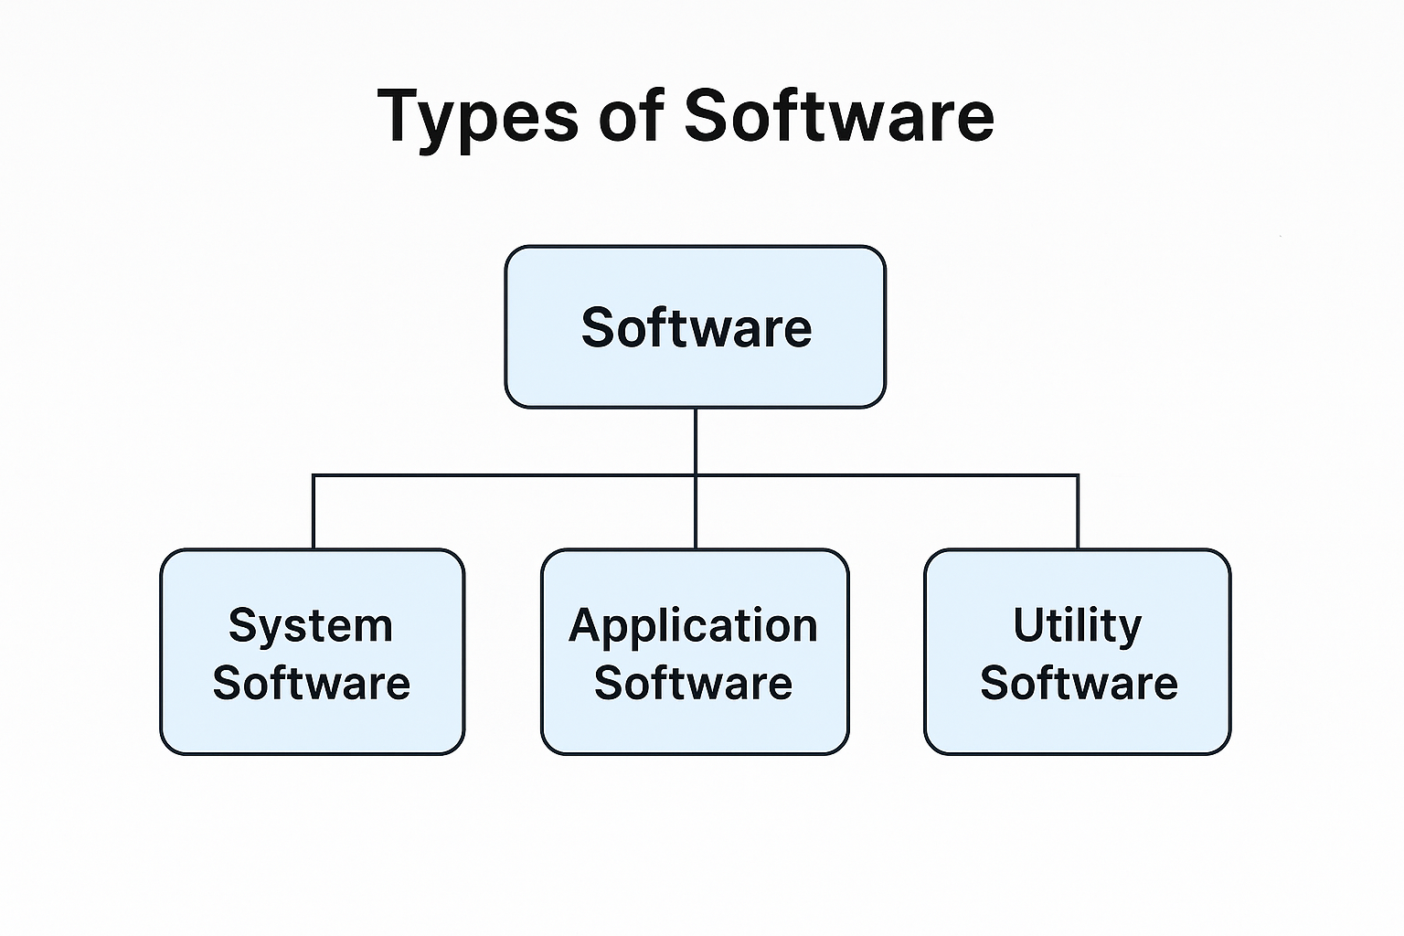
SECTION 1: Types of Software

Slide 5
SECTION 1: Types of Software
1. State one advantage and one disadvantage of custom‑made software.
2. State one advantage and one disadvantage of off‑the‑shelf software.
Notes:
1. State one advantage and one disadvantage of custom‑made software.
Example prompts:
Advantage: Designed exactly for the organisation’s needs
Disadvantage: More expensive and takes longer to develop
2. State one advantage and one disadvantage of off‑the‑shelf software.
Example prompts:
Advantage: Cheaper and available immediately
Disadvantage: May not meet all business needs

Slide 6
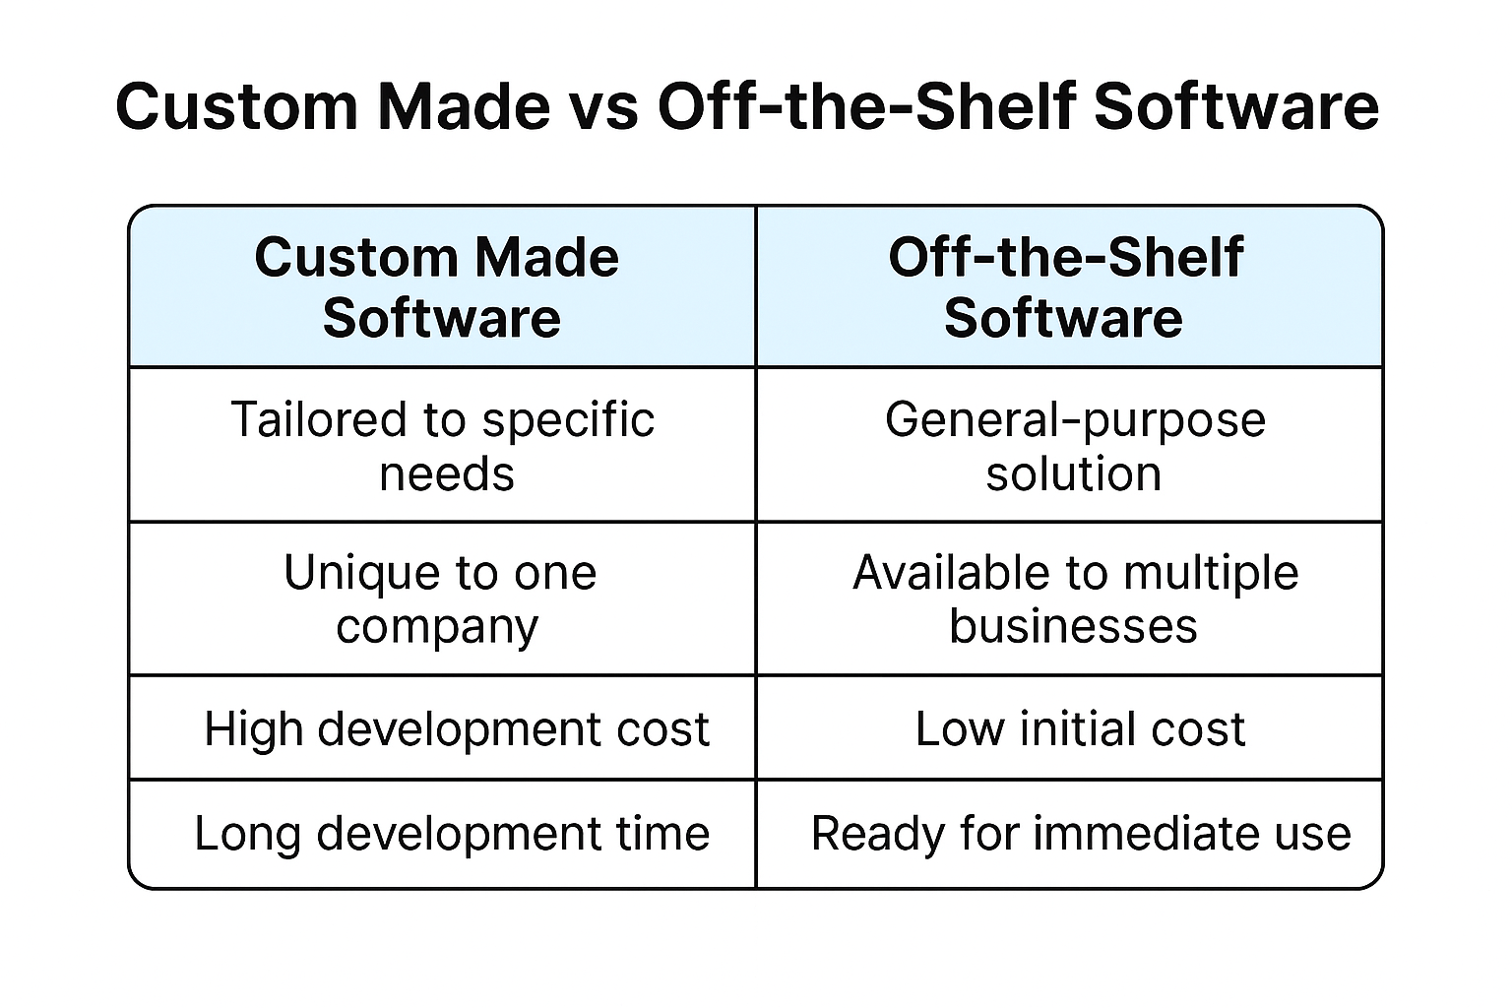
SECTION 1: Types of Software

Slide 7
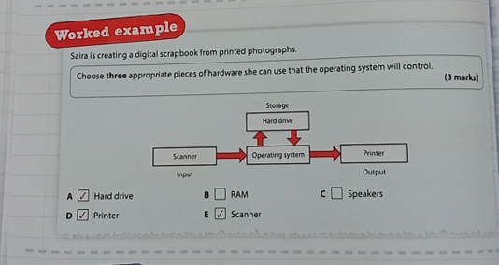
SECTION 2: Operating Systems
    Operating Systems
    Utility applications
    User interfaces
    Software installation and upgrades

Slide 8
SECTION 2: Operating Systems & Applications
1. State two functions of an operating system.
Example prompts:
  File management
  Managing hardware drivers
  Security
  Resource allocation
2. Explain the role of a device driver.
Example: A driver allows the OS to communicate with hardware such as printers or keyboards.
3. Give one example of a utility application and explain its purpose.
Examples:
  Disk defragmenter → reorganises files
  Firewall → blocks unauthorised access
  Antivirus → removes malware
Notes:
1. State two functions of an operating system.
Example prompts:
File management
Managing hardware drivers
Security
Resource allocation
2. Explain the role of a device driver.
Example: A driver allows the OS to communicate with hardware such as printers or keyboards.
3. Give one example of a utility application and explain its purpose.
Examples:
Disk defragmenter → reorganises files
Firewall → blocks unauthorised access
Antivirus → removes malware

Slide 9
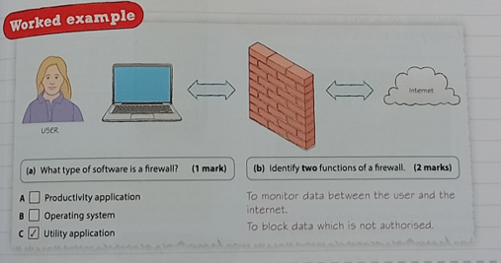
utility application
Notes:
Utility application are small programs which improve the performance of a device and usually only carry out one task. They can be software programs or built into the operating system.
There are lots of different types of utility applications – here is one example:
Software firewalls
Purpose: to prevent hackers and viruses from infecting a device. Firewalls monitor data moving in and out of the a device (or network) and block unwanted traffic, such as a virus.
The firewall will monitor traffic, detect anything that it thinks is untrustworthy and block it from reaching your computer.
Antivirus and firewalls might be similar but they’re not the same – here is the difference between firewalls and antivirus:
Antivirus:- is a software application that protects us against Malware, such as viruses, by either preventing them from entering our system or detecting them and deleting them.
Firewalls:- it could be stop a hacker from breaking into your system and to monitor data between the user and the internet

Slide 10
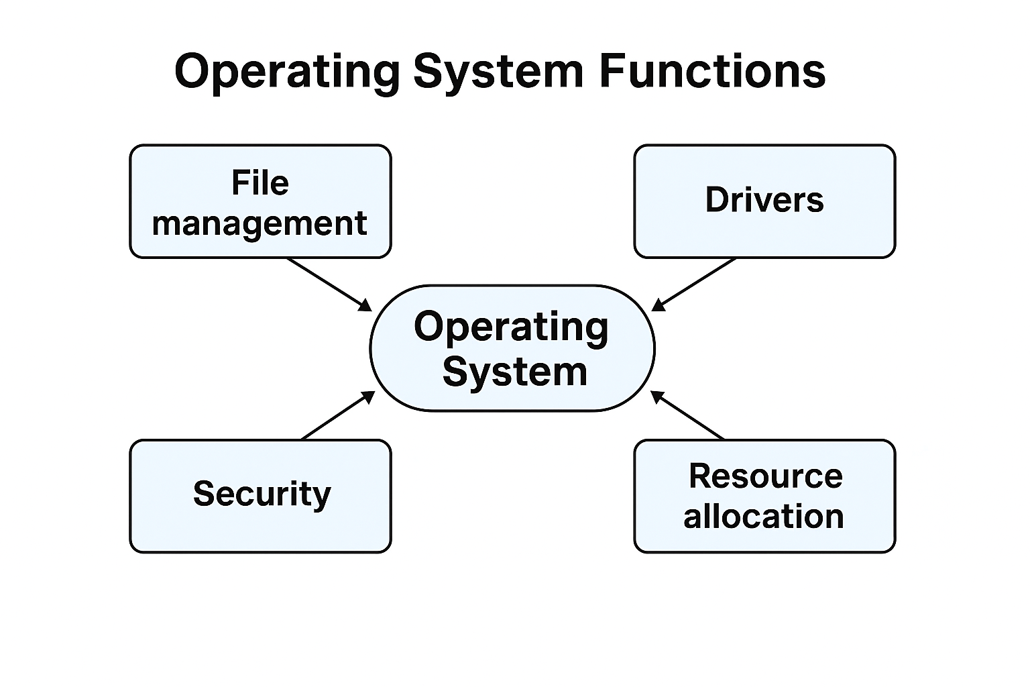
SECTION 2: Operating Systems & Applications

Slide 11
SECTION 2: Operating Systems & Applications
4. Describe one difference between a GUI and a command‑line interface.
Example: GUI uses icons and windows; CLI uses typed commands.
5. Give two features of a GUI operating system.
Example prompts:
  Easy to use
  Accessible features (zoom, screen reader)
  Drag‑and‑drop
6. Give one benefit of mobile operating systems.
Example: Touchscreen‑friendly, simple interface, app‑based design.

Slide 12
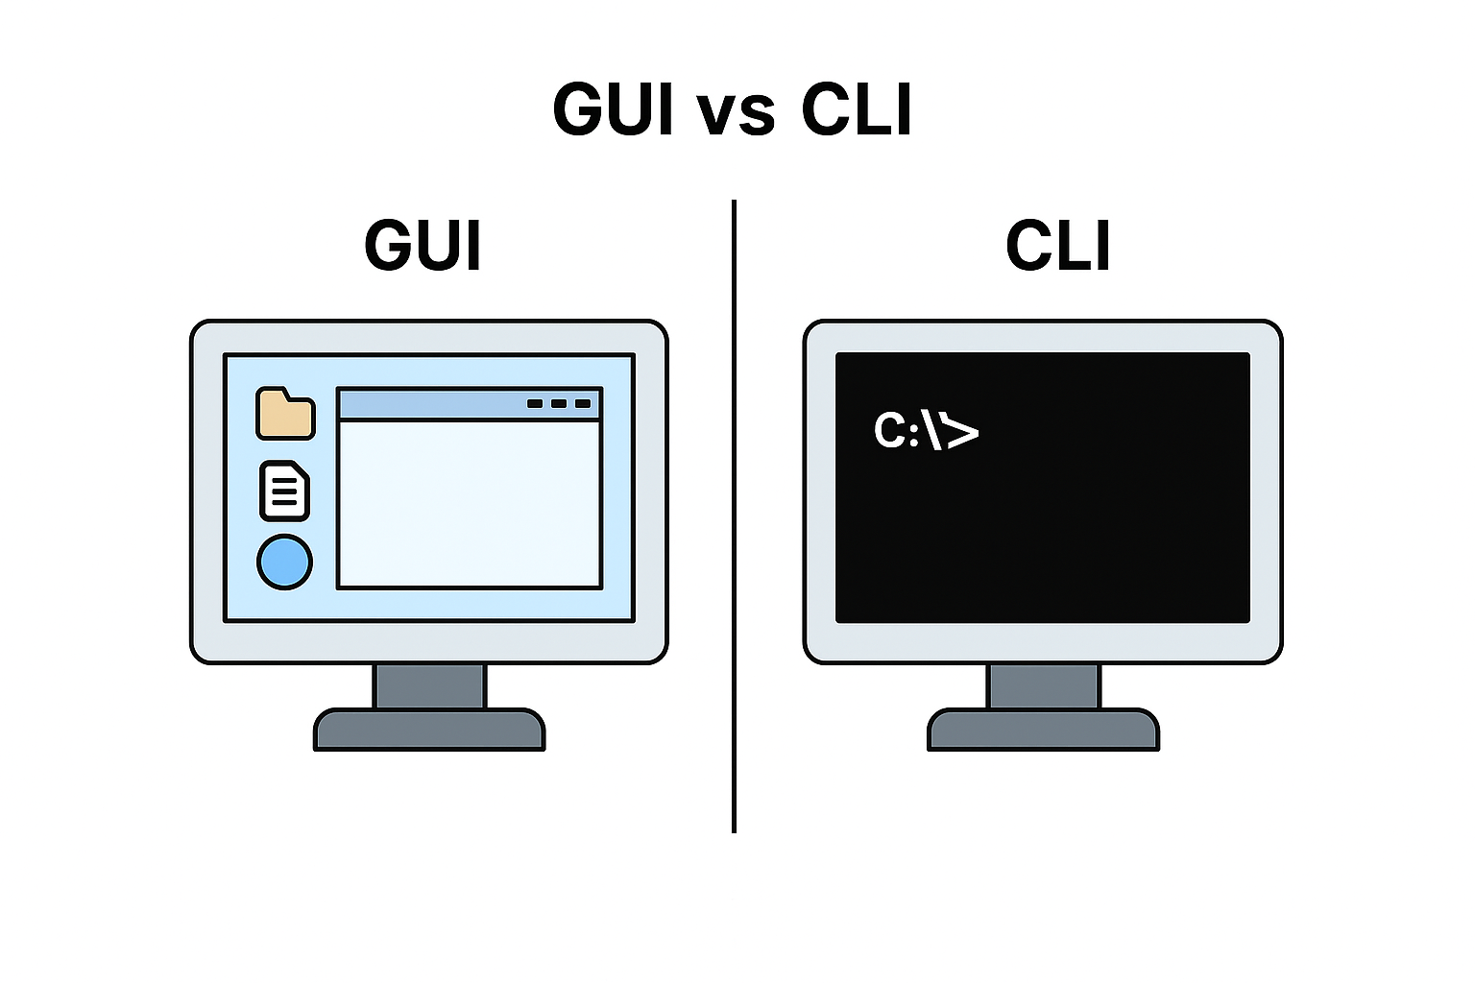
SECTION 2: Operating Systems & Applications

Slide 13
SECTION 2: Operating Systems & Applications
1. What is a productivity application? Give two examples.
Examples:
Word processor
Spreadsheet
Presentation software
Web‑authoring tool
2. State one benefit of using a suite of productivity applications.
Example: All apps work together (e.g., copy from Word to PowerPoint easily).
3. List three factors to consider before installing a new operating system.
Example prompts:
  Hardware compatibility
  Cost
  Speed
  Security features
  Accessibility needs
  Compatibility with existing apps

Slide 14
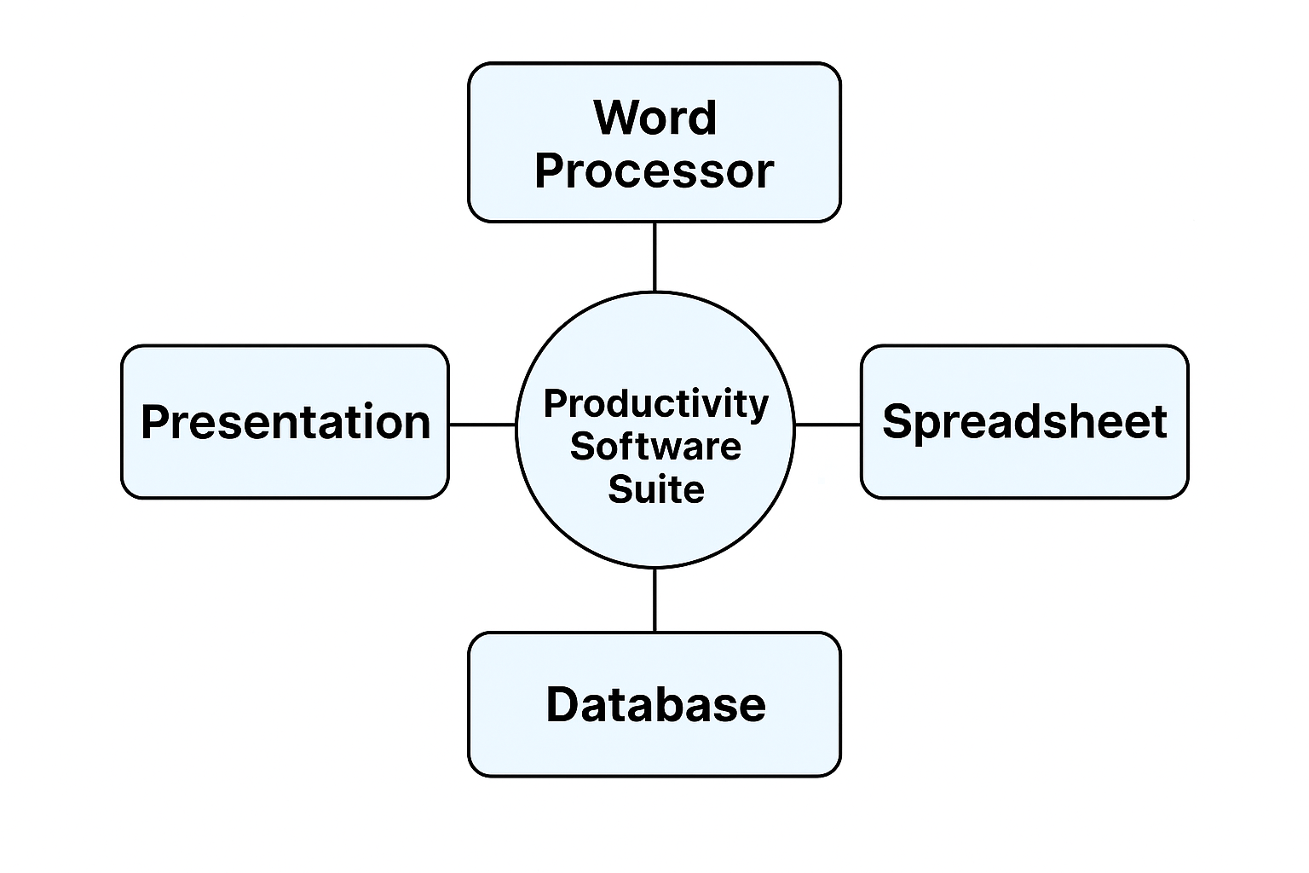
SECTION 2: Operating Systems & Applications

Slide 15
SECTION 3: Software installation and upgrades
Why do we need SW Installation and upgrade?
Give your reasons

Slide 16
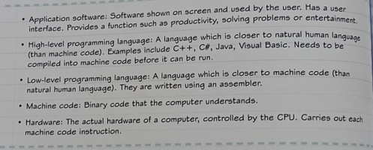
SECTION 4: Programming Concepts & Hierarchical Structure
Notes:
1. Put the following in the correct order from highest level to lowest level:
Machine code, Application software, Hardware, High‑level language, Low‑level language
2. Give one characteristic of a high‑level programming language.
3. Give one characteristic of a low‑level programming language.
Example: It is close to machine code and difficult for humans to read.
4. Explain the difference between high‑level and low‑level languages.

Slide 17
SECTION 4: Programming Concepts & Hierarchical Structure
1. Put the following in the correct order from highest level to lowest level:
Machine code, Application software, Hardware, High‑level language, Low‑level language
2. Give one characteristic of a high‑level programming language.
3. Give one characteristic of a low‑level programming language.
Notes:
1. Put the following in the correct order from highest level to lowest level:
Machine code, Application software, Hardware, High‑level language, Low‑level language
2. Give one characteristic of a high‑level programming language.
3. Give one characteristic of a low‑level programming language.
Example: It is close to machine code and difficult for humans to read.
4. Explain the difference between high‑level and low‑level languages.

Slide 18
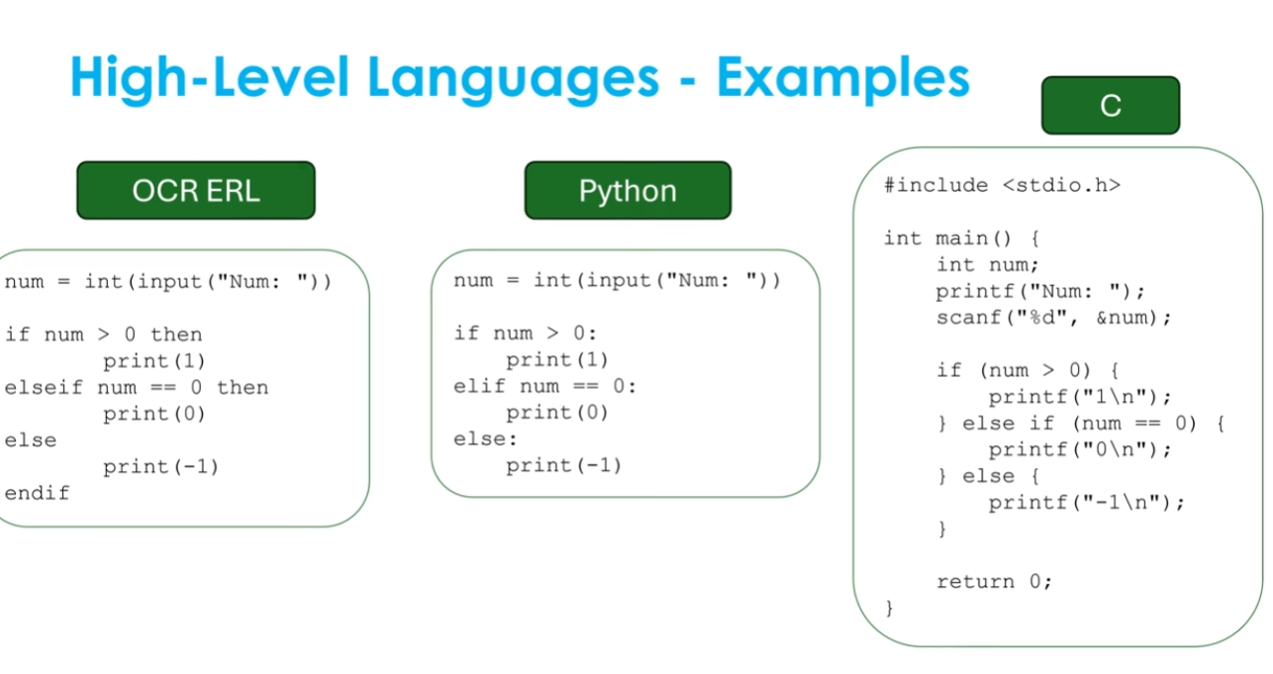
SECTION 4: Programming Concepts & Hierarchical Structure

Slide 19
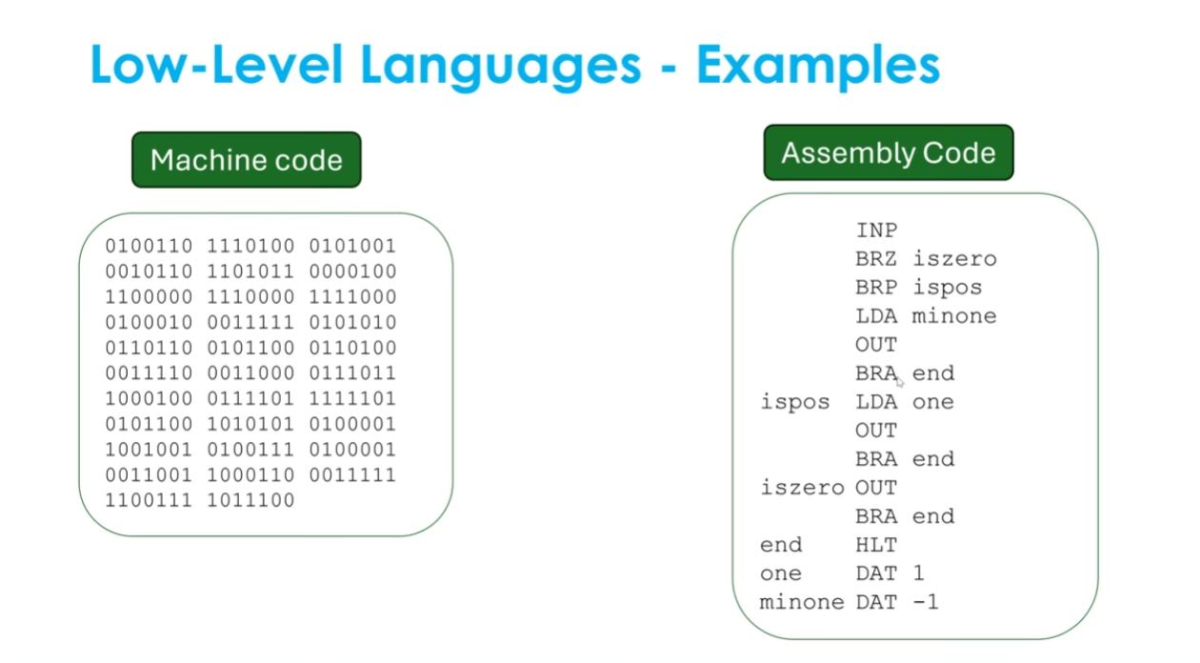
SECTION 4: Programming Concepts & Hierarchical Structure

Slide 20
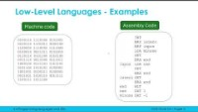
SECTION 4: Programming Concepts & Hierarchical Structure

Slide 21
SECTION 4: Programming Concepts & Hierarchical Structure
5. Explain the difference between high‑level and low‑level languages.
Example prompt: High‑level = easier to understand Low‑level = closer to binary and hardware
6. Match the programming type to its description:
Imperative
Procedural
Event‑driven
Object‑oriented
Descriptions include:
  Uses objects and classes
  Runs when a user clicks or interacts
  Uses step‑by‑step instructions
  Tells the computer how to do something

Slide 22
Learning Aim C – Software & Programming Concepts
2‑Mark Questions
Software: State the difference between system software and application software.
Operating Systems: Give two functions of an operating system.
Utility Applications: Name two utility programs and state their purpose.
User Interfaces: Give one advantage of a GUI and one advantage of a CLI.
Software Installation: State two reasons why software updates are important.
Programming Concepts: Define the term “algorithm”.
Programming Languages: Give one high‑level and one low‑level language.

Slide 23
SECTION 5: Flowcharts
1. Identify the correct BCS symbol for each purpose:
Start/End
Process
Decision
Input/Output
2. Create a flowchart for calculating weekly wages including overtime.
Example guidance:
  Input hours worked
  If hours > 40 → calculate overtime
  Output total pay

Slide 24
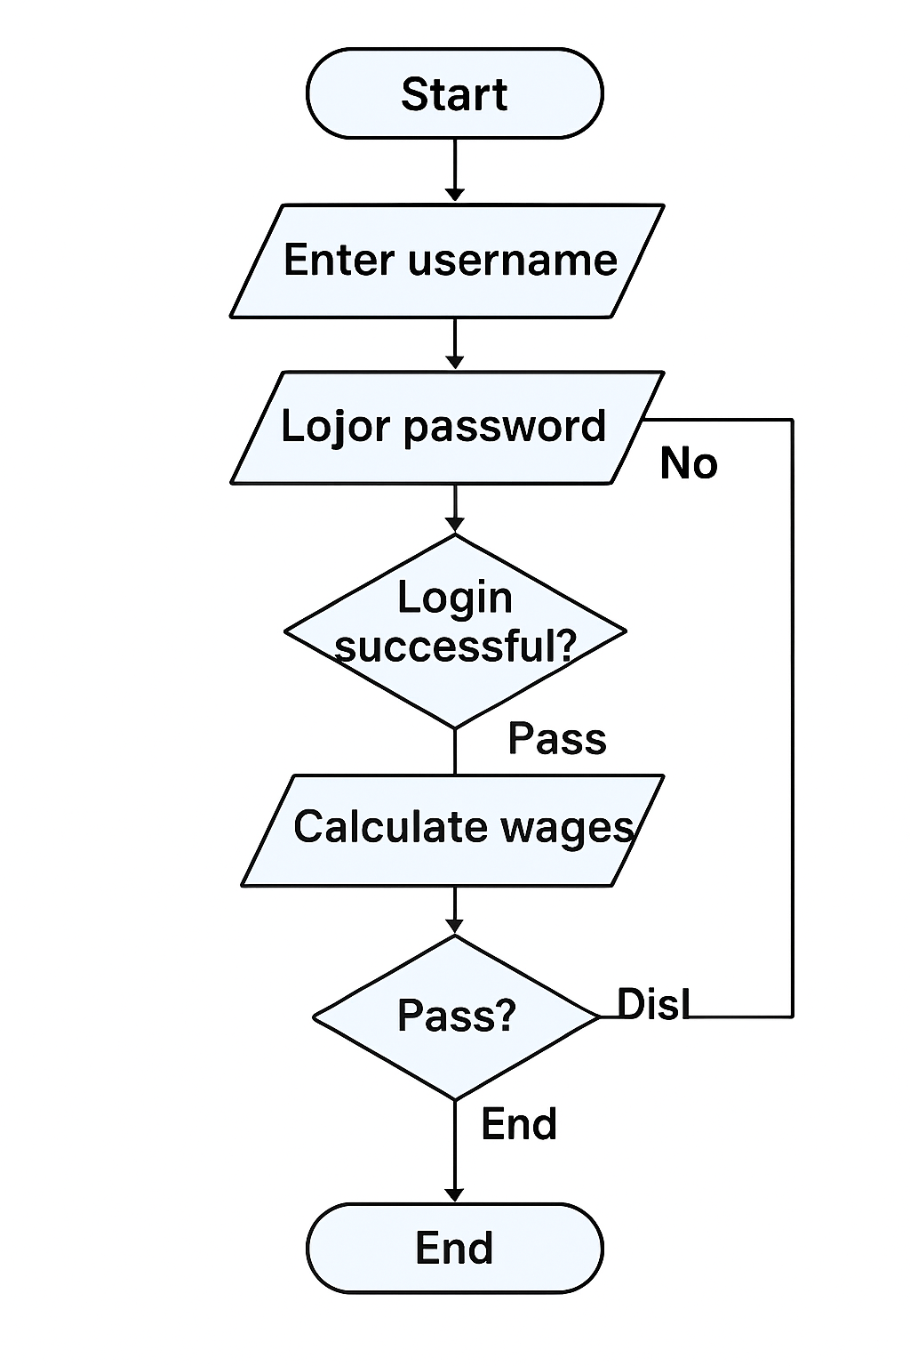
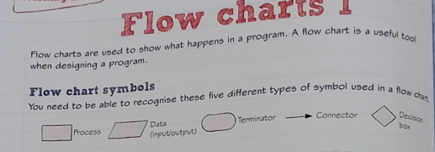
SECTION 5: Flowcharts

Slide 25
SECTION 5: Flowcharts
Create a flow chart to login to the college system using the two form Authentication

Slide 26
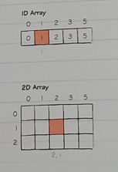
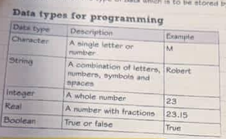

SECTION 5: Programming
    Programming - terminology
    Programming - data types
    Programming - data structures

Slide 27
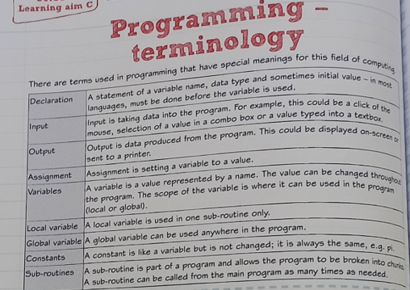

Slide 28
Learning Aim C – Software
2‑Mark Questions
Flow Charts: State what a flowchart is used for.
Programming Terminology: Define “variable”.
Data Types: Give two examples of data types used in programming.
Data Structures: Name one data structure and state its purpose.

Slide 29
Learning Aim C – Software
8‑Mark Questions
Software: Evaluate how different types of software support business operations.
Operating Systems: Explain how operating systems manage hardware and software resources.
Utility Applications: Analyse how utility software improves system performance and security.
User Interfaces: Compare different user interfaces and justify which is most suitable for a given user group.
Software Installation: Discuss the challenges and benefits of installing and upgrading software in organisations.
Programming Concepts: Explain how algorithms and control structures are used to solve problems.
Programming Languages: Evaluate the suitability of different programming languages for different tasks.
Flow Charts: Explain how flowcharts help programmers design and debug programs.
Programming Terminology: Discuss the importance of variables, constants, and operators in programming.
Data Types: Analyse how choosing the correct data type affects program performance and accuracy.
Data Structures: Evaluate the use of arrays, lists, and records in storing and managing data.

Slide 30
SECTION 5: Extended Questions (Level 2 Merit/Distinction Style)
1. Compare custom-made and off-the-shelf software for a small business. Which would you recommend and why?
2. Explain how an operating system manages files, hardware, and security. Use examples.
3. Create a flowchart that converts exam marks into grades (A–F). Include at least three decision boxes.
4. Explain why high‑level languages are easier for beginners than low‑level languages. Give examples.
5. A company wants to upgrade its operating system. Describe three things they must check before upgrading.

