Slide 1
Unit 2: Technology Systems
Level: 2 Unit type: Mandatory

Slide 2
Learning aim A: Unit 2 Technology Systems
Explain how the components of technology systems work together.
Notes:
The main components of an Information and Communication Technology (ICT) system include hardware, software, databases, and networks. These components work together to process and share information effectively. For example, hardware such as servers, computers, and networking devices hosts the software (like an LMS platform) and stores data.

Slide 3
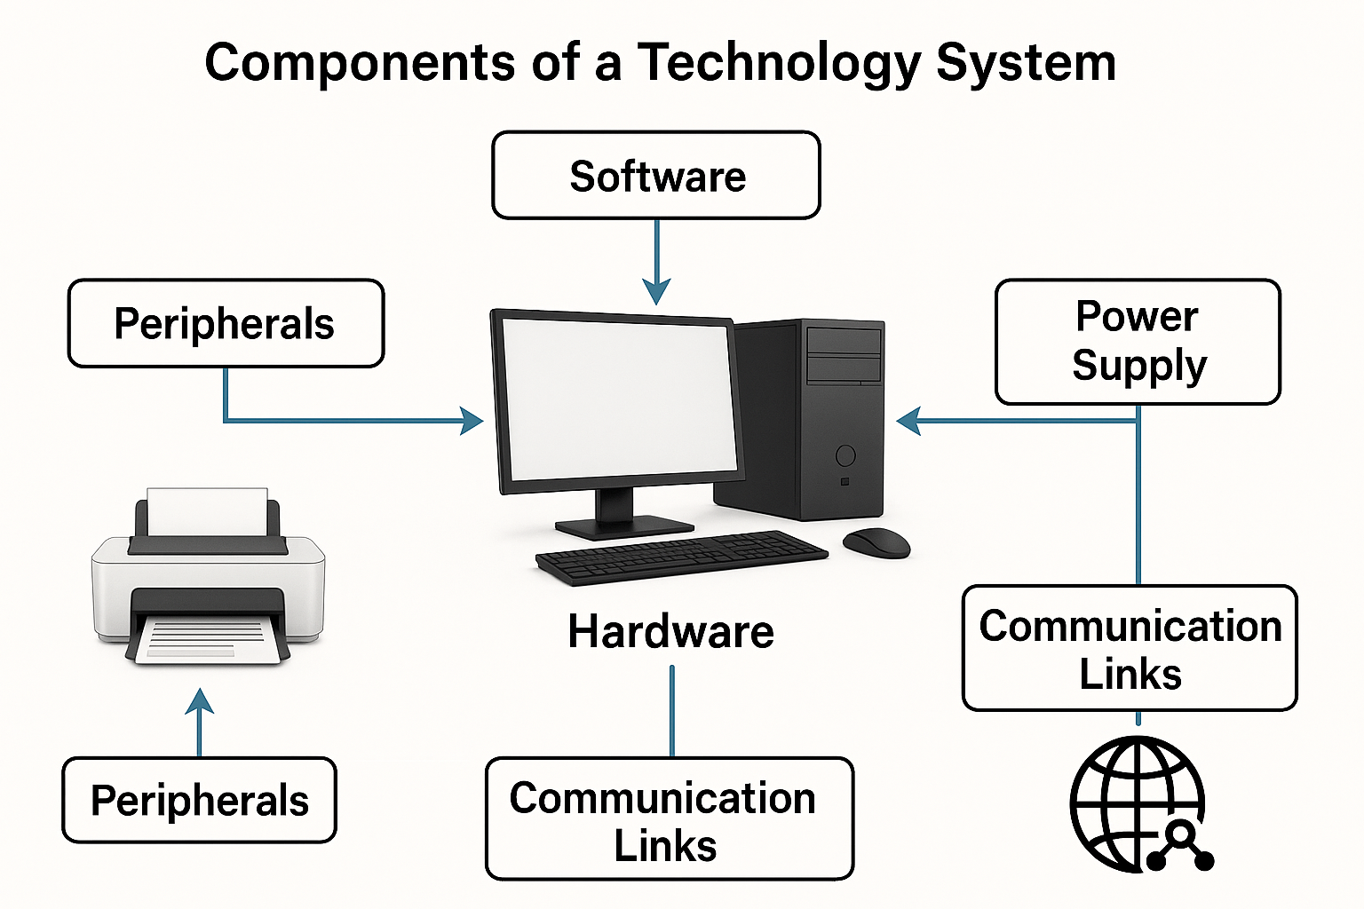
Components of a technology Systems

Slide 4
Section 1: Computer & Technology Systems
What is the difference between a computer and a technology system?
Why is digital data important in computer processing?
What components make up a complete technology system?
How do hardware and software depend on each other?
Notes:
A computer is a machine that processes digital data. A computer installation is made up of a collection of components to form a technology system. Technology is an essential component of industry and services. A technology system is the complete collection of components (Hardware, software, peripherals, power supplies, communication links) making up a single computer installation.
Digital data is crucial in computer processing because it allows for the efficient storage, manipulation, and transmission of information.
Technology components are the essential building blocks of modern digital and electronic systems, encompassing hardware, software, networking, and peripheral elements that work together to perform tasks efficiently.
Hardware and software are mutually dependent components of any computing system. Hardware refers to the physical components like CPU, RAM, storage devices, and input/output peripherals, while software is the set of instructions (programs) that tell the hardware what to do.

Slide 5
Section 2: Applications of Technology Systems
How is technology used in the construction sector?
Why is CAD/CAM important in manufacturing?
What technology systems are used in the finance sector?
How do robots improve efficiency in production lines?
How does retail use automated systems such as self‑checkouts?
Notes:
Building houses , factories, bridges and large buildings; architecture.
CAD and CAM are technology systems used to design component parts on a computer.
Involving money- most likely banking.
Retailers use automated systems like self-checkouts to enhance efficiency and customer experience.

Slide 6
Section 3: Issues in Technology Systems
What are common health and safety risks when using technology?
Why are passwords and authentication important?
What environmental issues arise from technology use?
How does sustainability influence technology design?
What is copyright, and why does it matter in digital systems?
Notes:
Health: RSI, posture issues, eye strain, electrocution/fire risks; use ergonomic setups, breaks, proper lighting, and secure equipment.
Security is important for personal and sensitive information, such as medical records, personal emails or financial information.
One of the biggest problem of environmental issue in technology is global warming- e.g. using electricity , especially if computers are left turned on overnight unused.
Disposing of old computers creates landfill and can releases dangerous chemicals.
Copyright is a legal protection that gives creators the exclusive right to control how their original works are used by others. Copyright legally protects ownership of data.

Slide 7
Section 4: Future Development of Technology Systems
Why do organisations invest in new technology systems?
How can improved technology give a competitive advantage?
How does automation reduce costs?
What performance improvements can new systems bring?
Notes:
Three main factors drive organizations to make strategic technology investments as their primary reason to do so:
The first factor is obsolescence which occurs when businesses need to maintain their existing systems because their outdated systems become too expensive to manage while their systems fail to work with new software.
The second factor for businesses to consider when assessing their growth needs is scalability which enables them to operate their business through automated systems that handle increasing work requirements without needing more manual effort.
The third factor for organizations to assess their security needs and legal compliance requirements is their new systems which provide superior defense against cybersecurity threats while enabling them to meet data protection regulations such as GDPR.
2. Modern businesses use advanced technologies to gain competitive advantages which their competitors cannot match. Two particular outcomes of this situation occur as separate results from it.
The first outcome of differentiation happens when a business introduces exclusive product attributes that enhance customer experience through features like an easy-to-use mobile application and real-time delivery monitoring. The advanced analytics systems provide leaders with market trend information that competitors will not discover until months later because the systems use data to transform "gut feelings" into accurate business strategies.
3. Digital transformation uses automation systems as its main method to decrease costs because they focus on automating tasks that involve The Dull The Dirty and The Dangerous work activities throughout the organization.
4. Throughput Performance enables organizations to process orders that require multiple days of handling to complete within a time frame that takes only seconds. The ERP (Enterprise Resource Planning) system establishes itself as a "single source of truth" which allows all company personnel to access identical accurate in formation.

Slide 8
Section 5: Hardware Devices
What are the differences between a PC, laptop, tablet and server?
Why are modern devices often multifunctional?
What are the advantages of solid‑state storage over magnetic storage?
How do input and output devices work together in a system?
Notes:
A server is powerful computer that controls other devices. The PC is multi-purpose computer that runs functional software such as word processing and spreadsheet. Laptop is a mobile (portable) computer. Tablet is a mobile device usually with a touch screen, about the size of clip board.
Modern technology devices and continually getting improved. Some of the reasons are competitive advantage, Reduced cost and improved performance.
SSD is much faster than HDD. And it has no moving parts so it's much durable.
Input puts data into the device and output sends data out of device.

Slide 9
Section 6: Automated Systems & Data Capture
How does a self‑service checkout combine hardware and software?
What is the purpose of a barcode reader?
How does RFID differ from OCR and OMR?
Which device would be most suitable for a warehouse inventory system, and why?
Notes:
1. Self-Check-In Machine
Technology Used: This system uses a Barcode or QR code scanner to read a passenger's mobile boarding pass. It may also use OCR to scan a passport and convert the printed text into digital passenger data.
2. Automated Vacuum Cleaner
Input Device: Sensors (e.g., infrared or touch sensors) to detect obstacles like walls or furniture.
Software Role: The software finds the sensor data as an "obstacle" and triggers a command to turn the vacuum in a different direction.
3. Supermarket Self-Service Checkout
Input Device: Barcode scanner (to show items) or a Touchscreen (to select items without barcodes).
Output Device: Speaker (to give instructions/beeps) or a Monitor (to show the total price).
4. Matching Task (Worked Example)
OMR: Connects to "Can reduce errors because the user has to choose options available".
OCR: Connects to "Creates a digital file that can be backed up to keep safe".

Slide 10
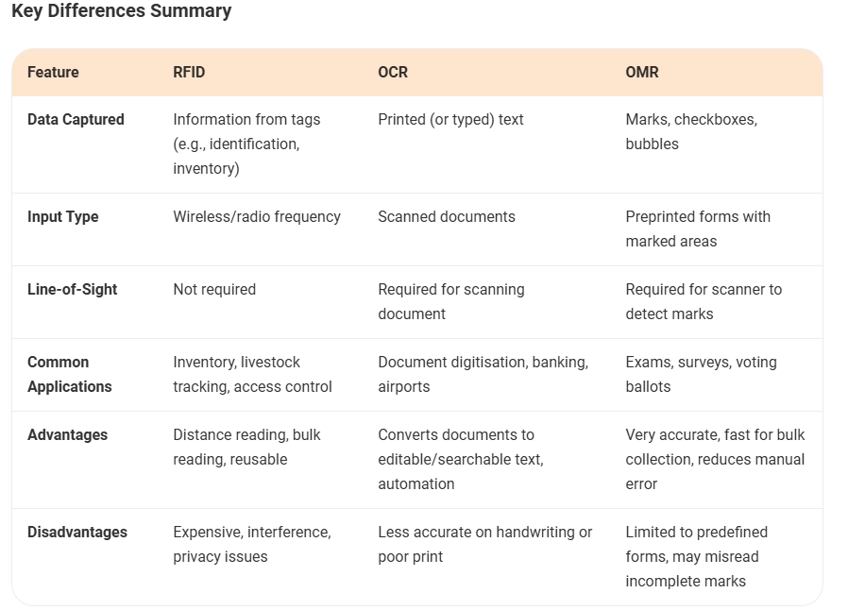
Section 6: Automated Systems & Data Capture
How RFID, OCR, and OMR Differ 1. RFID (Radio Frequency Identification) What it is: A technology that uses radio waves to identify and track tags attached to objects. How it works: An RFID reader sends out radio signals to an RFID tag, which responds with its stored data. Main use: Inventory tracking, access cards, toll systems, library books, logistics. Key points: Works without line of sight Can read multiple tags at once Very fast and automatic 2. OCR (Optical Character Recognition) What it is: A technology that converts printed or handwritten text into editable digital text. How it works: A scanner or camera captures an image → OCR software identifies the characters and converts them into text. Main use: Digitizing documents, reading license plates, scanning books, extracting text from images. Key points: Needs a clear visual image Requires good lighting and clear print Converts shapes of characters into text 3. OMR (Optical Mark Recognition) What it is: A system that detects shaded bubbles or marks on paper. How it works: Uses optical sensors to identify darkened areas. Main use: Multiple‑choice exam sheets (like standardized tests), surveys, lottery tickets. Key points: Detects marks, not text Needs pre‑defined boxes or bubbles Very accurate and fast for structured forms

Slide 11
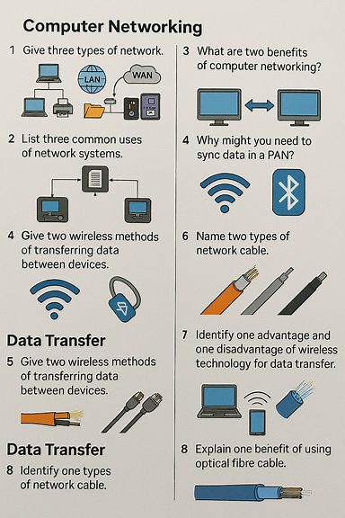
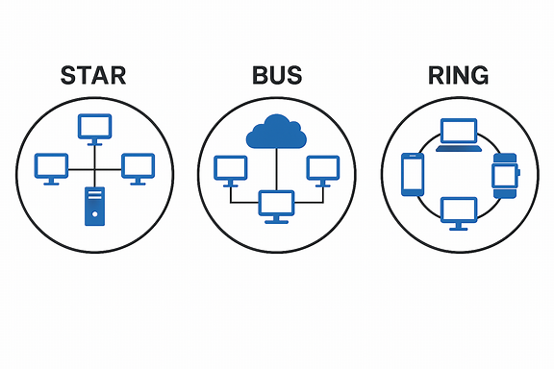
Section 7: Computer Networking
Explain the concepts, applications and implications of networks,

Slide 12
Section 7: Computer Networking
Multiple‑choice questions
Which type of network covers the smallest area? A. WAN B. LAN C. PAN D. Mobile broadband
Which of the following is a common use of a network? A. Increasing electricity usage B. Sharing resources C. Slowing down communication D. Reducing device compatibility
What is a key benefit of networking computers? A. Data becomes harder to access B. Devices cannot communicate C. Files can be shared easily D. Users must work offline
Which technology is most commonly used to synchronise data between a smartphone and a smartwatch? A. Fibre‑optic cable B. Bluetooth C. Coaxial cable D. Mobile broadband

Slide 13
Section 7: Computer Networking
Explain the purpose of a LAN in a school environment.
Give two benefits of using a WAN for a large business.
Describe what a PAN is and give one example of a device that might be part of it.
Explain why synchronising data in a PAN is important for users.
Compare the uses of LANs and WANs in organisations.
A user streams films, shares files with friends and plays online games. Explain how networking supports these activities.

Slide 14
Section 7: Computer Networking
Multiple‑choice questions
Which wireless technology is best for transferring large files quickly? A. Bluetooth B. Wi‑Fi C. Coaxial D. UTP
Which cable type uses light to transmit data? A. UTP B. Coaxial C. Fibre‑optic D. HDMI
Which of the following is a drawback of Bluetooth? A. Low power usage B. Short range C. High speed D. Works without pairing

Slide 15
Section 8: Data Transfer
Multiple‑choice questions
Which wireless technology is best for transferring large files quickly? A. Bluetooth B. Wi‑Fi C. Coaxial D. UTP
Which cable type uses light to transmit data? A. UTP B. Coaxial C. Fibre‑optic D. HDMI
Which of the following is a drawback of Bluetooth? A. Low power usage B. Short range C. High speed D. Works without pairing

Slide 16
Section 8: Data Transfer
Compare wireless and cabled methods of data transfer in terms of speed, range, and security.
A photographer needs to transfer large video files from a camera to a computer. Discuss which transfer method would be most suitable and why.
State one benefit and one drawback of using Wi‑Fi for data transfer.
Describe one situation where UTP cable would be more suitable than Wi‑Fi.
Explain why fibre‑optic cables are used for long‑distance communication.

