Slide 1
Unit 1: The Online World
Learning Aim B: Investigate components of the internet and how digital devices exchange and store information

Slide 2
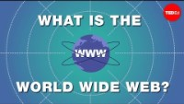

Worldwide web
Explain the following topics in your own words-
●the worldwide web (WWW) as the collection of information on computers connected to the internet
● the role of a web server

Slide 3
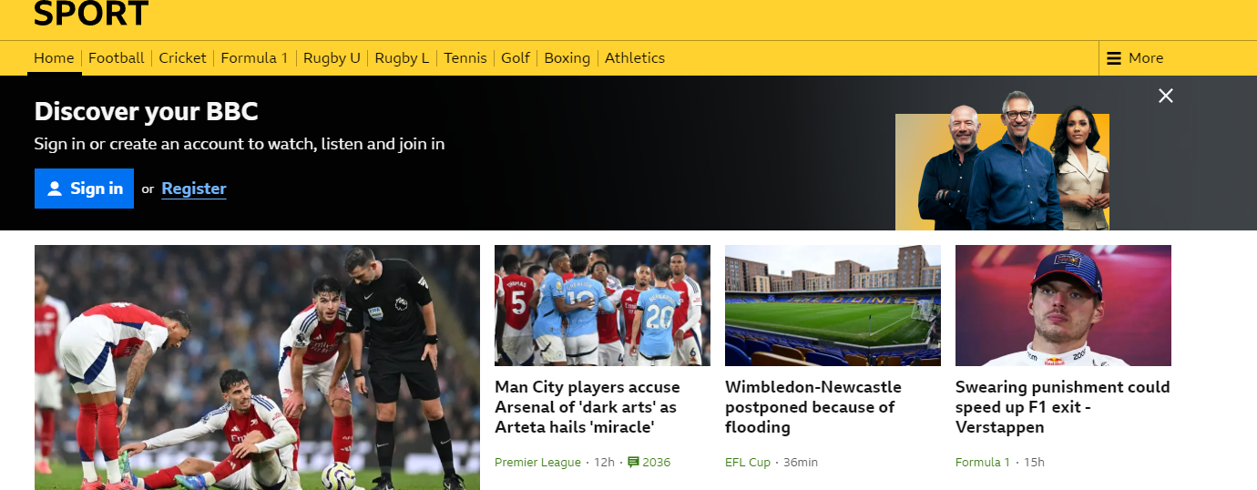
Worldwide web
Explain the following topics in your own words-
● the structure of a website in terms of hyperlinked web pages.

Slide 4
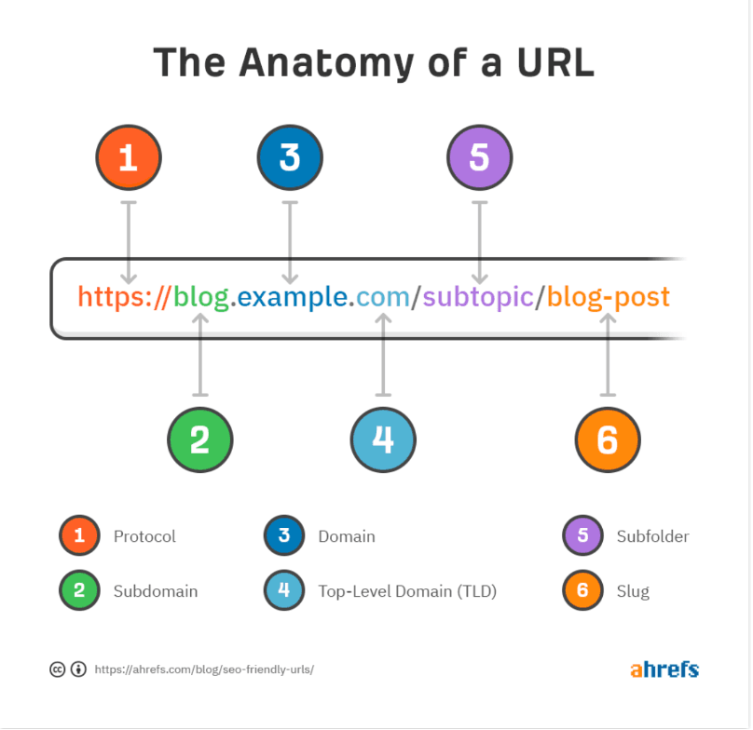
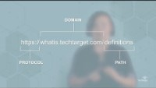
Worldwide web
Explain the following topics in your own words-
● the components of a Uniform Resource Locator (URL) and the roles of each component

Slide 5
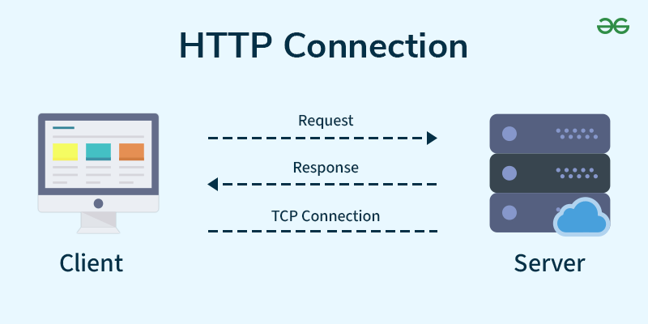
Worldwide web
Explain the following topics in your own words-
● the function of HyperText Transfer Protocol (HTTP)

Slide 6
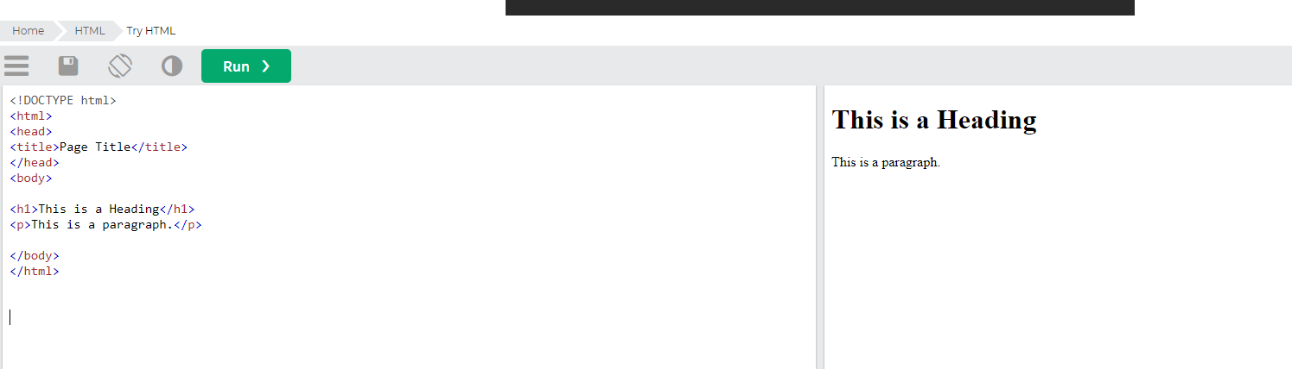
Worldwide web
Explain the following topics in your own words-
● HyperText Markup Language (HTML) is used to create web pages
● the main features of HyperText Markup Language (HTML) source code

Slide 7
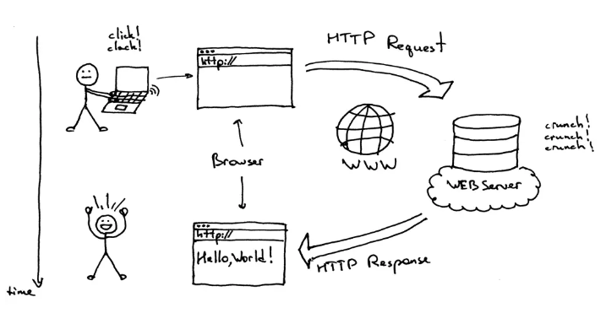
Worldwide web
Explain the following topics in your own words-
● the role of internet browsers in requesting and displaying web page components

Slide 8
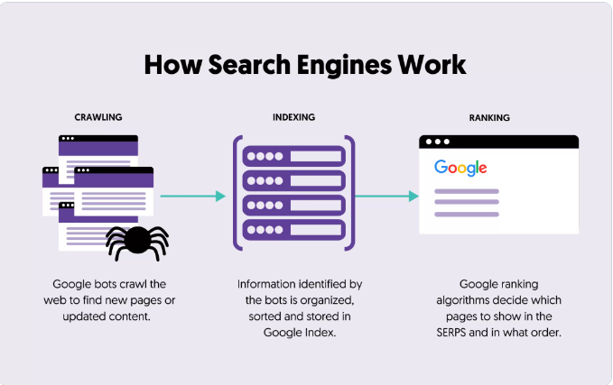
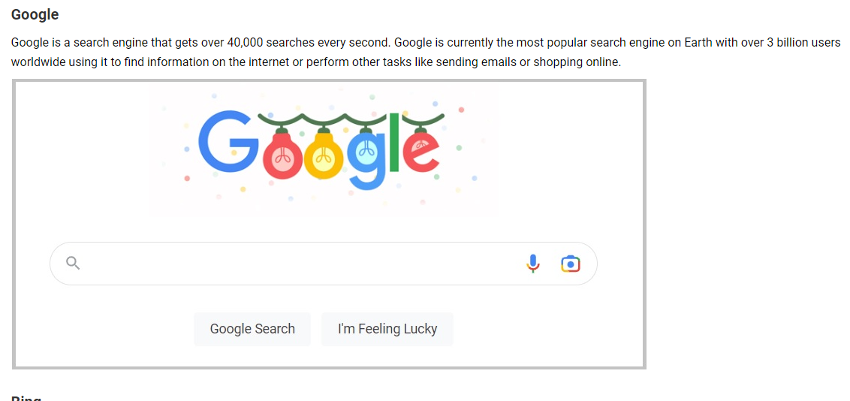
Worldwide web
Explain the following topics in your own words-
● the purpose of search engines and their role in maintaining indexes of web pages

